Slide 1
Take Off Angles and HFTA
By Kevan Nason
N4XL

Slide 2
Why Use HFTA?
Have you ever asked
How high should my antenna be?
Is it worth spending a lot more money for a taller tower?
My tower is 30 ft tall. Is adding 10 ft worth all the work?

Slide 3
Why Use HFTA?
I’m about to buy a house. Is it in a good location for HF radio?
Bob and I have the same antenna at the same height. We both run 100 watts. He lives 3 miles from me and often works Japan when I can’t. Why?
What antenna changes do I have to make to reach JA?

Slide 4
References
ARRL Antenna Book, 23rd Edition
Operating Instructions for HFTA, version 1.04
VHF monopole antenna at variable height - 3D radiation pattern - 4NEC2 simulation – EA4FSI
5 element yagi 4nec2 antenna pattern - Felipe Ceglia

Slide 5
References
The Radio Propagation, Luxorion, http://www.astrosurf.com/luxorion/qsl-propa.htm
Diffraction – wave spreading around an edge, Blog at Wordpress.com, https://esfsciencenew.wordpress.com/2009/03/26/diffraction-wave-spreading-around-an-edge/
Low Band DXing, 5th Edition, ON4UN
HFTA, ARRL, by Dean Straw, N6BV

Slide 6
The Decibel

Slide 7
The decibel is a measure of power. It makes it easy to compare things.

Slide 8
Antenna Patterns & Take Off Angle

Slide 9
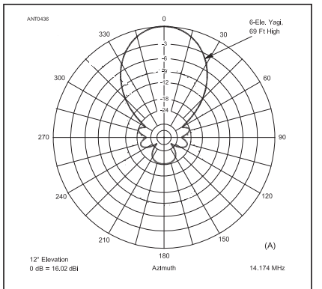
Yagi Transmit Lobes
Ref. A

Slide 10
3D Yagi Transmit Lobes
Ref. D

Slide 11
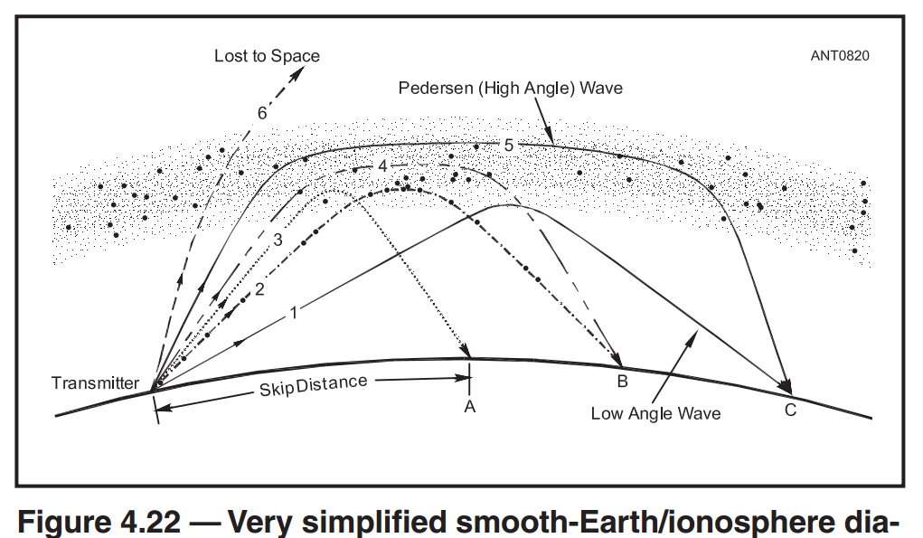
Take Off and Arrival Angles
Ref. A

Slide 12
Take Off and ARRIVAL Angles
Ref. G

Slide 13
Take Off Angle and Height
Ref. C

Slide 14
HFTA (HF Terrain Assessment) The Plot Area

Slide 15
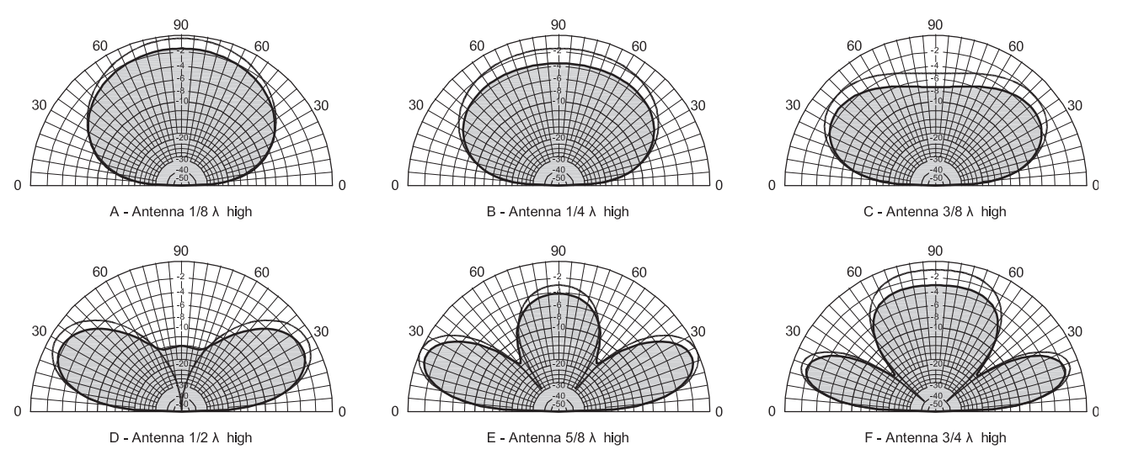
Take Off Angle and Height
Ref. A

Slide 16
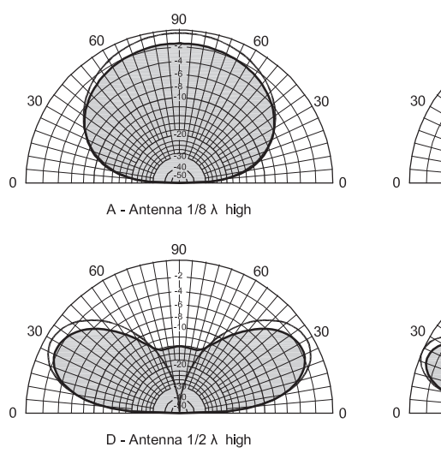
Take Off Angle Graph
Rotate
Ref. A

Slide 17
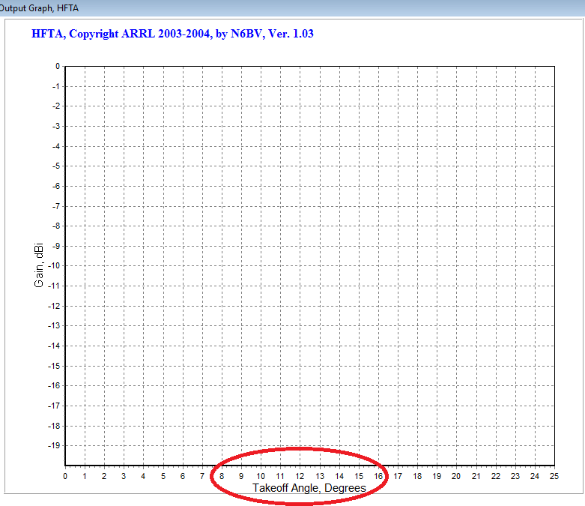
HFTA Take Off Angle Graph
Ref. H

Slide 18
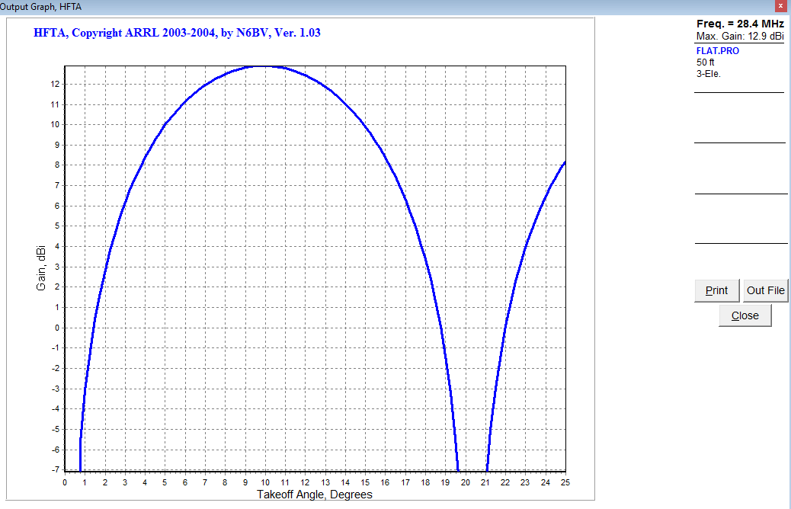
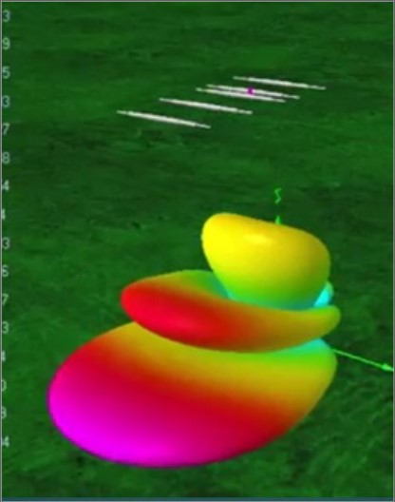
HFTA - Lobe
Lobes
Ref. H

Slide 19
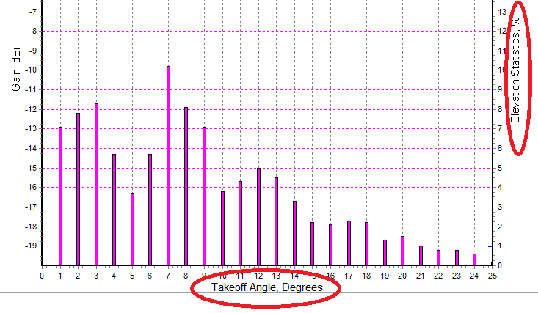
HFTA Elevation Statistics
Ref. H

Slide 20
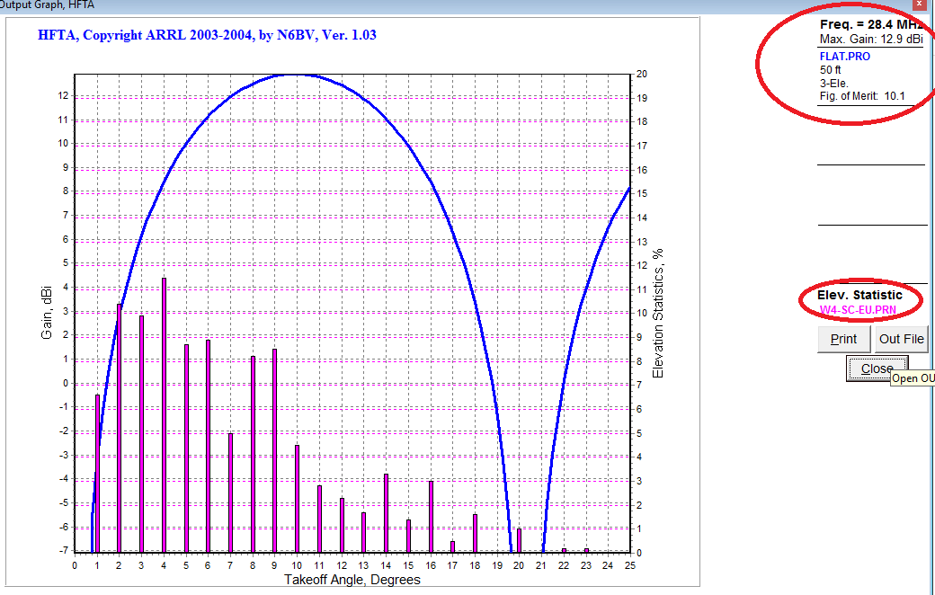
HFTA – Lobe & Statistics - EU
Ref. H

Slide 21
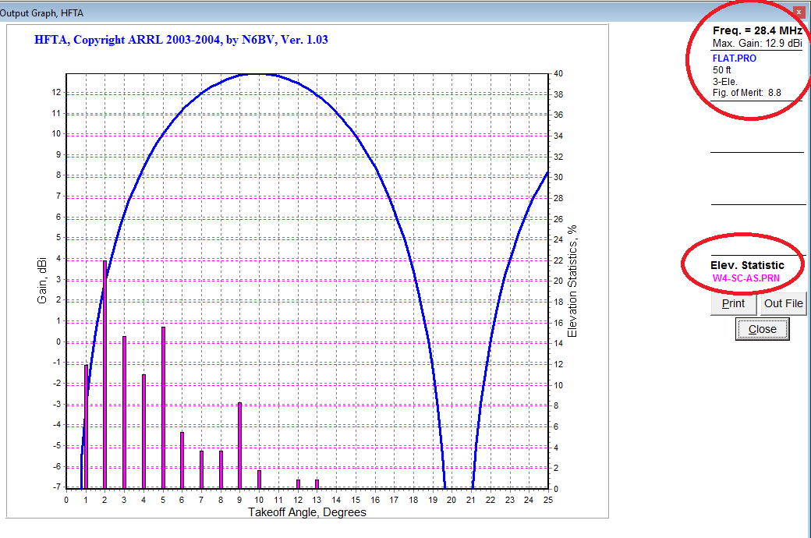
HFTA – Lobe & Statistics - AS
Ref. H

Slide 22
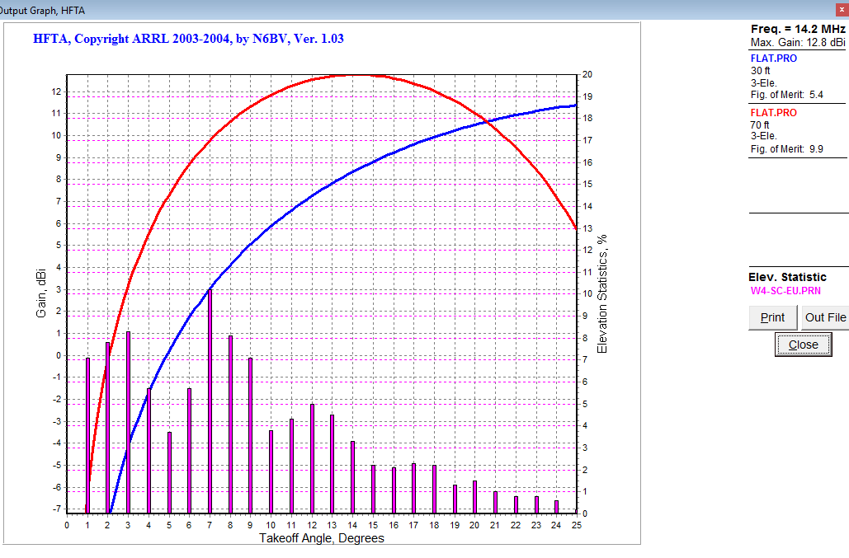
HFTA – 30 vs 70 ft
Ref. H

Slide 23
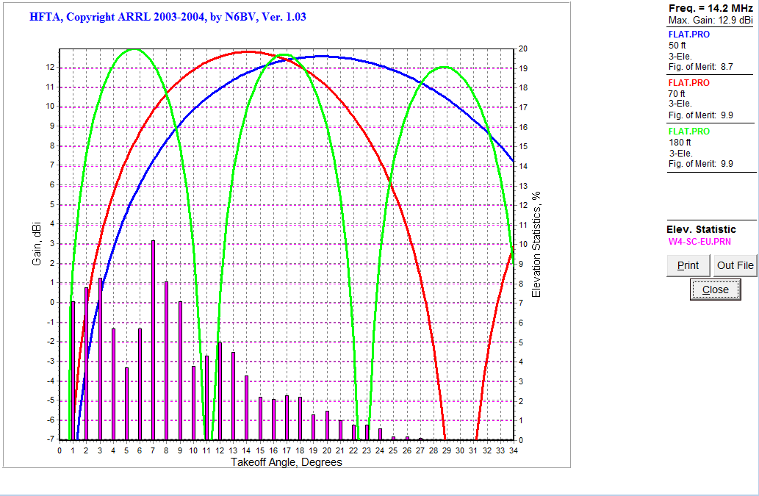
HFTA – 50-70-180
Ref. H

Slide 24
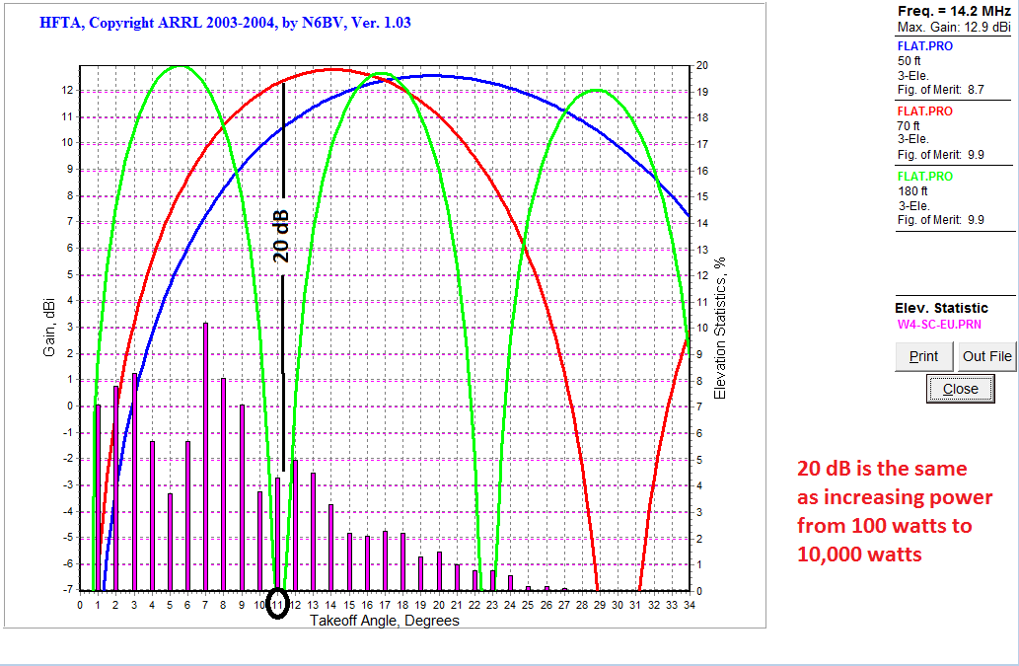
HFTA – 50-70-180 at 11 degrees
Ref. H

Slide 25
HFTA (HF Terrain Assessment) Stacks

Slide 26
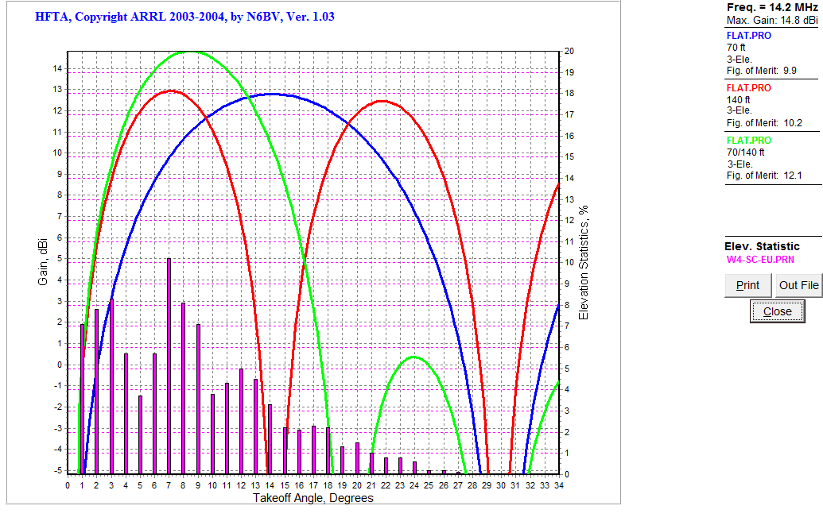
HFTA – 70/140 ft Stack
- Can use one or both antennas
- Combo shows higher angle rejection
Ref. H

Slide 27
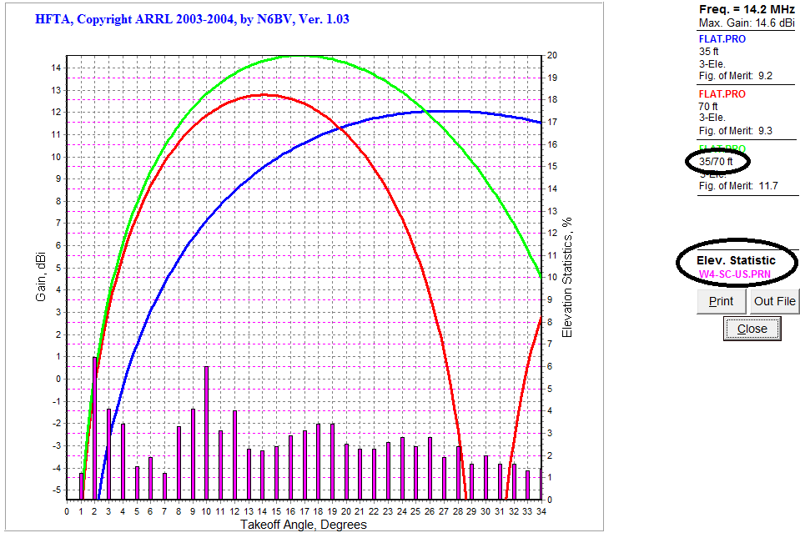
HFTA – 35/70 ft Stack to US
Ref. H

Slide 28
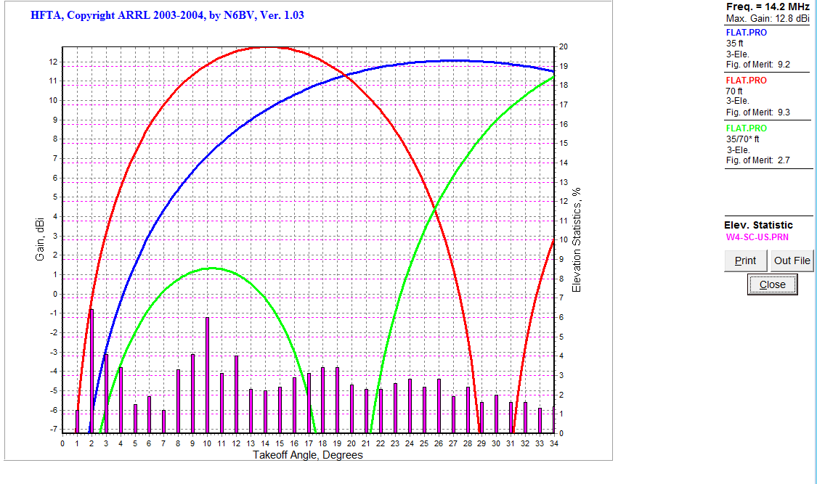
HFTA – 35/70 ft Out of Phase
Here the 70 ft antenna is out of phase
Ref. H

Slide 29
HFTA (HF Terrain Assessment) Terrain Effects

Slide 30
Terrain effects
Ref. A

Slide 31
Terrain effects
Ref. F

Slide 32
Terrain effects
Ref. E

Slide 33
Terrain effects
N4XL to EU
Ref. H

Slide 34
Terrain effects
N4XL to SA
Ref. H

Slide 35
N4XL to EU at 50 ft
N4XL to SA
Ref. H

Slide 36
N4XL to SA at 50 ft
N4XL to SA
Ref. H

Slide 37
N4XL to EU at 50 or 70
N4XL to SA
Ref. H

Slide 38
N4XL to US at 50 or 70
N4XL to SA
Ref. H

Slide 39
N4XL to EU at 50 or 70 ft on 10 mtrs
N4XL to SA
Ref. H

Slide 40
Using HFTA
If you have a multi band antenna like a tribander or trapped dipole look at all frequencies and find a good compromise height
Examine performance in several directions
If you can put up more than one antenna, see what combination works best to cover the most angles

Slide 41
Sources for Terrain data
K6TU website: https://www.k6tu.net/
Free terrain downloads.
Pay for use features such as can integrate HFTA and VOACAP propagation predictions
MicroDEM - complicated

Slide 42
N6BV comments
Accuracy is ± 3 dB so don’t obsess over small differences in plotted results
Verify results by plotting three different heights one foot apart centered around the desired height. Compare those results and throw out any outlier.
Ref. B

Slide 43
N6BV comments
HFTA analyzes horizontal polarization only. Best with directional arrays (Yagi’s and Quads)
Stacked antennas should be more than ½ wavelength apart or false gain will be shown
HFTA does not take into account manmade structures like water towers or buildings.
Ref. B

Slide 44
N6BV comments
Elevation angles were computed for all the times over the 11-year solar cycle when each band is actually open. The degree to which the antennas chosen for a particular terrain cover all these angles, the more effective will be those antennas/terrain for all periods of the solar cycle
Ref. B

Slide 45
N6BV comments
Figure of Merit (FOM) is only a “snapshot” of a complex situation. You can easily find situations where the elevation response of an antenna over complex terrain is better at low elevation angles than another antenna that has a higher FOM over the entire range of possible elevation angles. Low angles are especially important during periods of low solar activity, when the only possible modes of propagation are low-angle modes
Ref. B

Slide 46
N6BV comments
…if you are using Shuttle Radar Topographic Mission (SRTM) terrain data … recognize that a radar will see the tops of trees in a dense forest, not necessarily seeing the underlying ground.
On Dipoles: … ray tracing is still only done in the forward direction, despite the fact that a dipole is bidirectional
Ref. B

Slide 47
Summary
How well an antenna “plays” depends on take off angle to target area, antenna height, and local terrain
Lower is sometimes better
More than one antenna per band will help your overall signal presence
Design your antenna farm to cover all angles

Slide 48
A Parting Thought
No antenna will do everything. Each has pros and cons.
When someone asks you what antenna they should put up you should answer with a question. “What is it you want to do most?”

Slide 49
Questions?

Slide 50
Thanks!

